Slide 1
J METER

Slide 2
CONTENTS
J METER
PROTOCOLS
FEATURES OF J METER
HOW J METER WORKS
INSTALLATION OF JMETER
ELEMENTS OF J METER

Slide 3
J METER
J Meter is a software that can perform load test, performance-oriented business (functional) test, regression test, etc., on different protocols or technologies.
Stefano Mazzocchi of the Apache Software Foundation was the original developer of JMeter. He wrote it primarily to test the performance of Apache JServ (now called as Apache Tomcat project). Apache later redesigned JMeter to enhance the GUI and to add functional testing capabilities.

Slide 4
J METER
JMeter is a Java desktop application with a graphical interface that uses the Swing graphical API. It can therefore run on any environment / workstation that accepts a Java virtual machine, for example − Windows, Linux, Mac, etc.

Slide 5
Protocols
The protocols supported by JMeter are −
Web − HTTP, HTTPS sites 'web 1.0' web 2.0 (ajax, flex and flex-ws-amf)
Web Services − SOAP / XML
Database via JDBC drivers
Directory − LDAP
Messaging Oriented service via JMS
Service − POP3, IMAP, SMTP
FTP Service

Slide 6
J Meter Features
Being an open source software, it is freely available.
It has a simple and intuitive GUI.
J Meter can conduct load and performance test for many different server types − Web - HTTP, HTTPS, SOAP, Database via JDBC, LDAP, JMS, Mail - POP3, etc.
It is a platform-independent tool. On Linux/Unix, J Meter can be invoked by clicking on J Meter shell script. On Windows, it can be invoked by starting the jmeter.bat file.
It has full Swing and lightweight component support (precompiled JAR uses packages javax.swing.* ).

Slide 7
JMeter Features
J Meter store its test plans in XML format. This means you can generate a test plan using a text editor.
Its full multi-threading framework allows concurrent sampling by many threads and simultaneous sampling of different functions by separate thread groups.
It is highly extensible.
It can also be used to perform automated and functional testing of the applications

Slide 8
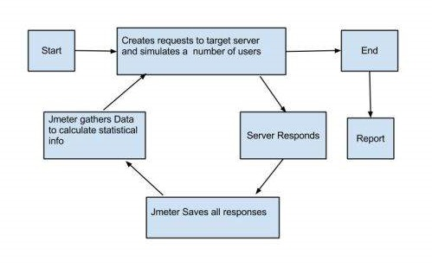
How JMETER Works
J Meter simulates a group of users sending requests to a target server, and returns statistics that show the performance/functionality of the target server/application via tables, graphs, etc

Slide 9
Installation of J Meter
J Meter is pure Java desktop application, it requires a fully compliant JVM 6 or higher. You can download and install the latest version of Java SE Development Kit
Installation of J Meter is extremely easy and simple. You simply unzip the zip/tar file into the directory where you want J Meter to be installed

Slide 10
Launch J Meter
You can start J Meter in 3 modes
GUI Mode
Server Mode
Command Line Mode

Slide 11
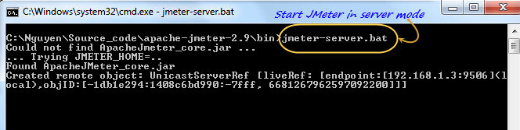
Start J Meter in Server Mode
Server mode is used for distributed testing.
This testing works as a client-server model. In this model, J Meter runs on a server computer in server mode. On a client computer, J Meter runs in GUI mode.
To start the server mode, you run the bat file bin\jmeter-server.bat as below figure

Slide 12
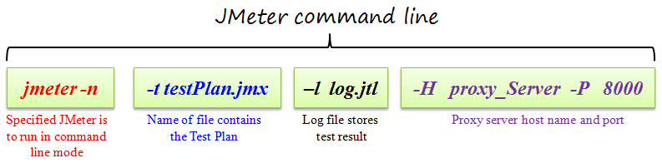
Start JMeter in command line mode
JMeter in GUI mode consumes much computer memory. For saving the resource, you may choose to run JMeter without the GUI. To do so, use the following command options

Slide 13
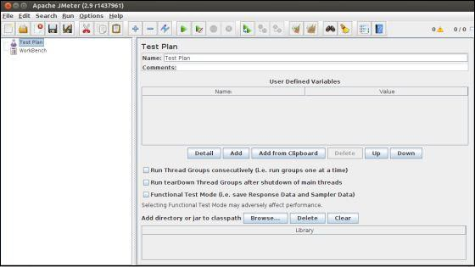
Start JMeter in GUI Mode
If you are using Window, just run the file /bin/jmeter.bat to start JMeter in GUI mode

Slide 14
TEST PLAN
A Test Plan can be viewed as a container for running tests. It defines what to test and how to go about it. A complete test plan consists of one or more elements such as thread groups, logic controllers, sample-generating controllers, listeners, timers, assertions, and configuration elements. A test plan must have at least one thread group

Slide 15
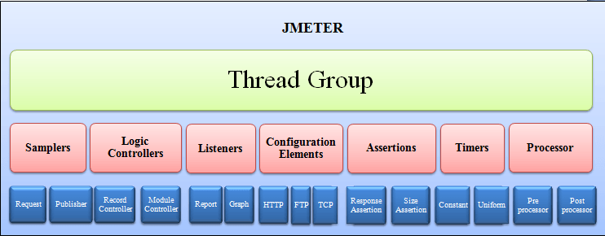
Element in JMeter
The different components of JMeter are called Elements. Each Element is designed for a specific purpose.
The figure below gives some common elements in Jmeter

Slide 16
J METER ELEMENTS
Thread Group
Samplers
Logic Controllers
Listeners
Configuration

Slide 17
THREAD GROUP
Thread Groups is a collection of Threads. Each thread represents one user using the application under test. Basically, each Thread simulates one real user request to the server.
The controls for a thread group allow you to Set the number of threads for each group.
For example, if you set the number of threads as 100; JMeter will create and simulate 100 user requests to the server under test

Slide 18
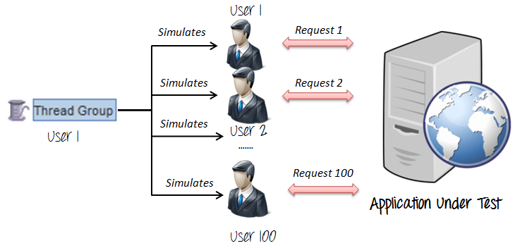
THREAD GROUP

Slide 19
SAMPLERS
JMeter supports testing HTTP, FTP, JDBC and many other protocols.
Thread Groups simulate user request to the server
But how does a Thread Group know which type of requests (HTTP, FTP etc.) it needs to make?
The answer is Samplers
The user request could be FTP Request, HTTP Request, JDBC Request…Etc.

Slide 20
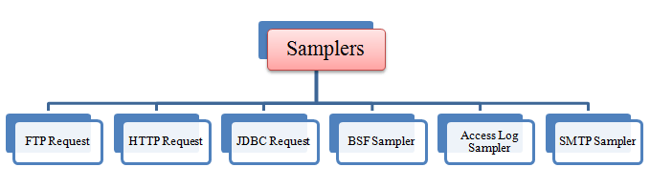
SAMPLERS

Slide 21

FTP REQUEST
Let’s imagine you want to performance test an FTP server. You can use an FTP request sampler in JMeter to do this task. This controller lets you send an FTP “download file” or “upload file” request to an FTP server.

Slide 22
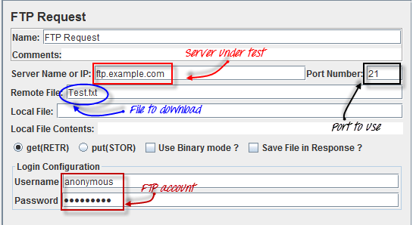
FTP REQUEST
For example, if you want to download a file “Test.txt” from an FTP server under test, you need to configure some parameters in JMeter as the figure below

Slide 23

HTTP request
This kind of sampler let us send an HTTP/HTTPS request to a web server.
Consider the example below. JMeter sends an HTTP request to Google website and retrieve HTML files or image from this website.

Slide 24
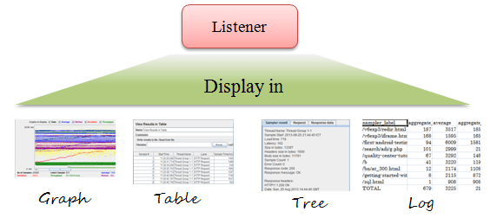
LISTENERS
Listeners: shows the results of the test execution. They can show results in a different format such as a tree, table, graph or log file

Slide 25
LOGIC COTROLLERS
Logic Controllers let you control the order of processing of Samplers in a Thread. Logic controllers can change the order of a request coming from any of their child elements.
Some examples are − For Each Controller, While Controller, Loop Controller, IF Controller, Run Time Controller, Interleave Controller, Throughput Controller, and Run Once Controller.

Slide 26
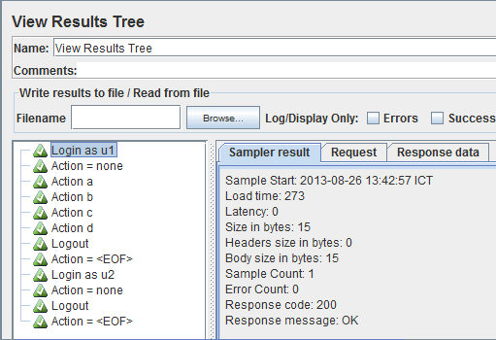
LISTENERS
View Result Tree show results of the user request in basic HTML format
Table Result show summary of a test result in table format

Slide 27
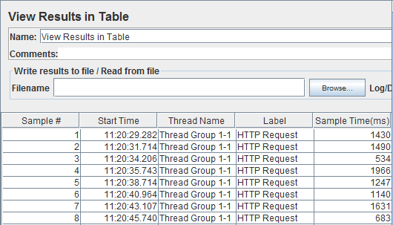
LISTENERS

Slide 28
LISTENERS
Sample Result Save Configuration
Graph Full Results
Graph Results
Assertion Results
View Results Tree
Aggregate Report
View Results in Table
Simple Data Writer
Monitor Results
Distribution Graph (alpha)
Aggregate Graph

Slide 29
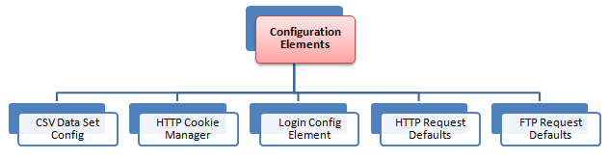
Configuration Elements
set up defaults and variables for later use by samplers.
The figure below shows some commonly used configuration elements in JMeter

Slide 30
TIMERS AND ASSERTIONS
A JMeter thread sends requests without pausing between each sampler. We can add a timer element which allows you to define a period to wait between each request.
Assertions allows to include some validation test on the response of our request made using a Sampler. Using assertions we can prove that our application is returning the correct data.

Slide 31
Queries

Slide 32
THANKS FOR VALUABLE TIME

